Slide 1
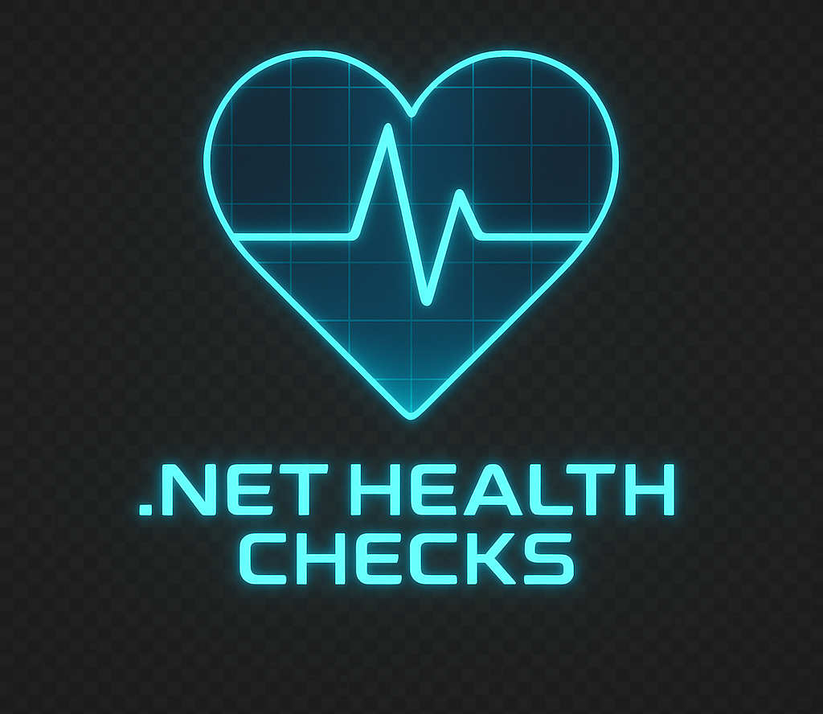
HealthChecks
The .Net feature you’re probably not using
Notes:
Hi! I’m Matthew Thomas, and this talk is going to be about health checks in .Net. This was something Microsoft introduced in .Net core 2.2 all the way back in 2018. So there’s a high likelihood that this tool will already be in your toolbelt. It can be a bit of a dry subject but it’s something that has saved me and my projects on numerous occasions. It’s a really simple concept, and it’s super easy to implement – with just a little bit of effort, you can get huge benefits, and today I’m going to show you how to do it. [CLICK]

Slide 2
Agenda
What are healthchecks?
How to implement a health check
How to get rich data out of your report
Some options for monitoring
How we use health checks at SSFCU
What Microsoft never told you….
Notes:
To kick it off, we’re going to take a second to define health checks. It’s both a concept and a technical term, and we’re going to taking a second to get some definitions out of the way so that everyone is on the same page.
We’ll then look at implementing health checks, building health reports, and ways you can get rich data out of that health report.
Manually monitoring these reports kind of sucks, so we’ll briefly talk about some options for monitoring as well as how we use health checks at the credit union.
I’ll wrap it up by showing you something that you won’t find in the documentation, and if there’s time, we can do a little Q and A [CLICK]

Slide 3

Matthew Thomas
Senior Applications Solution Analyst at SSFCU
Created and maintain build/deploy pipelines
Modernized high traffic services to .Net 8
Lead developer on Zelle integration services
Enjoy Scuba diving
Notes:
But first, who am I? As I said before, my name is Matthew Thomas
And for the last 7 and a half years I’ve worked at Security Service as a DevOps SME and .Net developer. I created and maintain our build and deployment pipelines in Azure DevOps, led modernization efforts for several high traffic web services, and am the primary developer on the services which will allow us to offer Zelle to the membership. Don’t quote me this, but I think the public facing bits will be out closer to the end of the year.
In my personal life, I have two daughters, and I enjoy Scuba diving. Due to the drought, I don’t get to go as often as I like, but this weekend I’m going to the Valhalla missile silo in Abilene. it is something I really enjoy doing, and I think everyone should try at least once.
[CLICK]

Slide 4
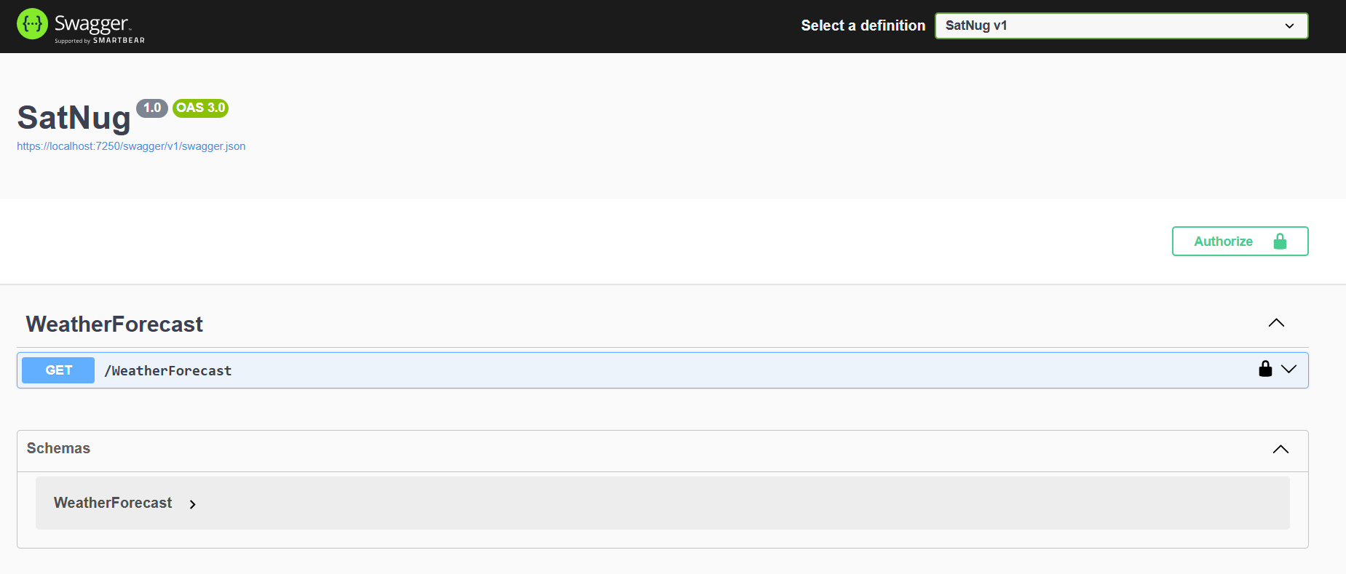
“Health Checks” the concept
Notes:
I mentioned that health checks are both a concept and a technical term – so let’s talk about it as a concept first.
When developing web applications, health checks allow you to inquire about the status of your application. They help ensure that your services are not just running, but running well. [CLICK]
Let’s take a look at this weather API. We’ve deployed it to production, the swagger page comes up, so everything’s good, time to go home, right?
Maybe…..
The trained eye will see that this service has, at a minimum, two extra dependencies that we’re not sure are functional.
The first one should be pretty obvious [CLICK] – it’s the service we’re fronting. We’re not the authority for weather forecasts – another service is. We query it, add some value, and return a response. So, we have a couple questions that need answering.
First and foremost, did the network people open a port so that our server can talk to their service? We can do everything right in code, but if we’re getting blocked at the network level, we don’t have a product.
And even if we can communicate with them, the credentials we use to authenticate with their service - those are still good, right? Because nobody ever fat fingers an api key ….right? RIGHT?
And assuming that’s all good, are they honoring their SLA, or is every request to them timing out? [CLICK]

Slide 5
“Health Checks” the concept
Notes:
The other dependency we’re taking on is less obvious, but equally important, and that’s our authentication service.
If we are requiring users of our service to authenticate – and we can’t verify their presented credentials – that’s a problem. [CLICK]

Slide 6
For every dependency in this application, can we actually use it?
Notes:
And so health checks the concept attempts to answer the question:
For every dependency in this application, can we actually use it? [CLICK]

Slide 7
Health Check the technical term
Checks the status of a single logical dependency
Implements IHealthCheck
CheckHealthAsync returns Task<HealthCheckResult>
Healthy
Degraded
Unhealthy
Notes:
And so that leads us to health checks the technical term.
A health check, as it pertains to .Net, is a class that checks the status of a single logical dependency. It implements IHealthCheck, which has a single function, CheckHealthAsync. This function returns a Task of HealthCheckResult.
We’ll expand on this in a minute, but a health check result [CLICK] is either healthy, degraded, or unhealthy.
And it’s up to you, the developer, to define the conditions that will yield a healthy, degraded, or unhealthy result - based on what 'normal' looks like for the thing you’re checking.
In practice, most things are either healthy or unhealthy – degraded is usually reserved for when a dependency exceeds its SLA. A good example would be when a database query executes successfully, but it just took too long to return the result [CLICK]

Slide 8
A collection of health checks is a health report
Each result in the report has the following
Name
Description
Duration
Tags
Status
The status of the report is the worst result in the collection
Notes:
A collection of health check results makes up a health check report. In addition to capturing the result of the CheckHealthAsync function, Microsoft also captures how long it took for that function to execute.
Those results are then used to build a HealthReport object.
The status of this report is the worst result in the collection – Which can suck because if you have 1 unhealthy thing, and everything else in the report is healthy, the entire report is unhealthy.
Let’s take a look at what a health check implementation looks like [CLICK]

Slide 9
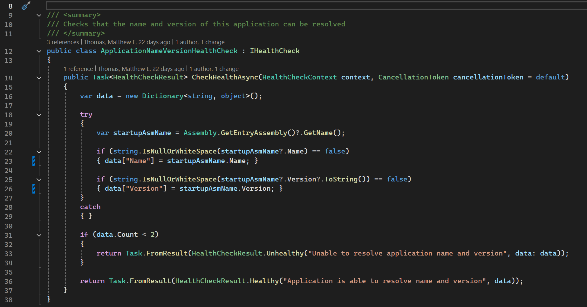
Notes:
This is a health check we at security service include in every application. It makes sure we can resolve the name and version of the entry assembly.
I know what you’re thinking: that’s an odd thing to check - but what it does for us, is ensures that the name and version of the application are included in the health report.
I’ll expand on this in a little bit, but we do health checks at deployment time, and this is a real easy way to sanity check that the service account properly configured on the box, and is allowed to run the application.
Independent of that, health reports must contain at least one check in them, and this is a real easy way to give developers a freebie.
You’ll notice that this check does not have a constructor – but that only by coincidence. These checks are going to be registered with the dependency injection container, so if you need other services or configuration from your application to implement your check, just resolve those services through the constructor like you would any other type in your application, and use them to build your response in the CheckHealthAsync function.
[CLICK]

Slide 10
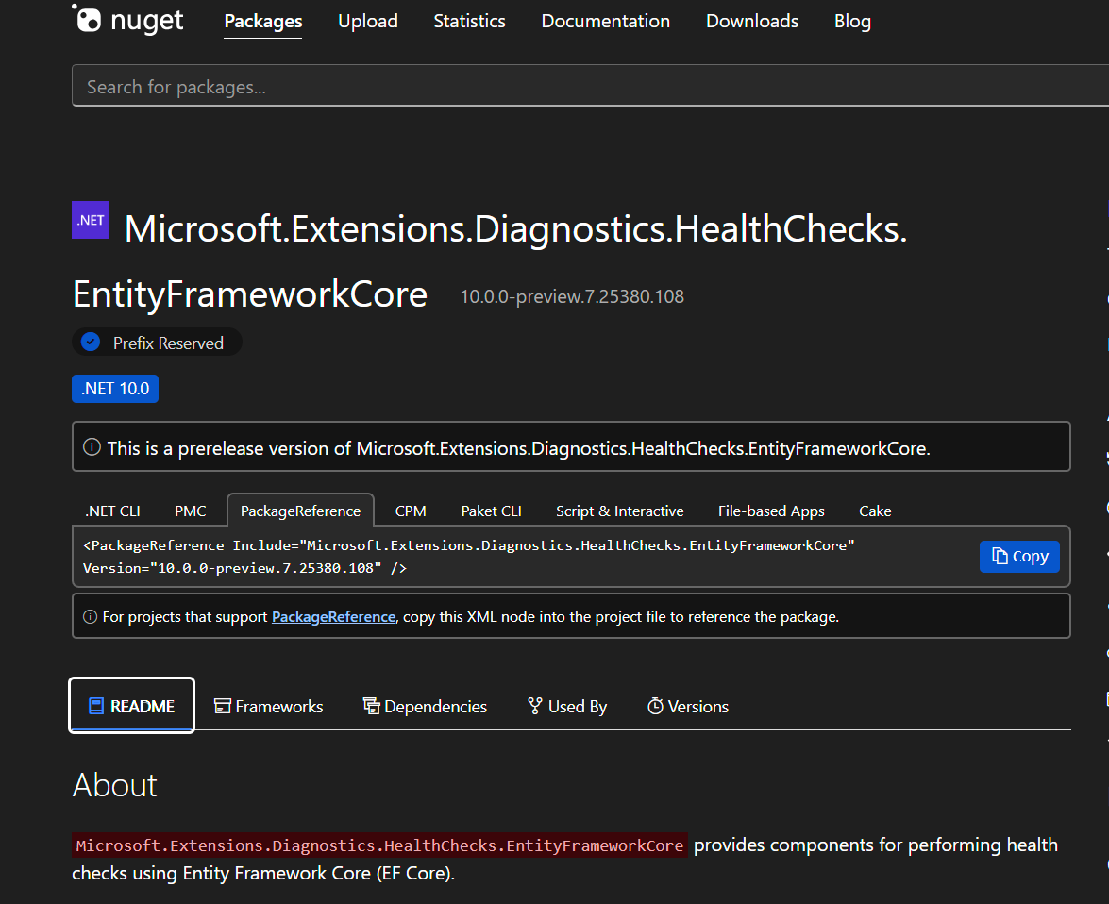
Health checks for common dependencies
Health checks for common dependencies are already written
Notes:
As you might expect, there’s already implementations out there for common dependencies, Microsoft put out one for Entity framework core [CLICK]

Slide 11
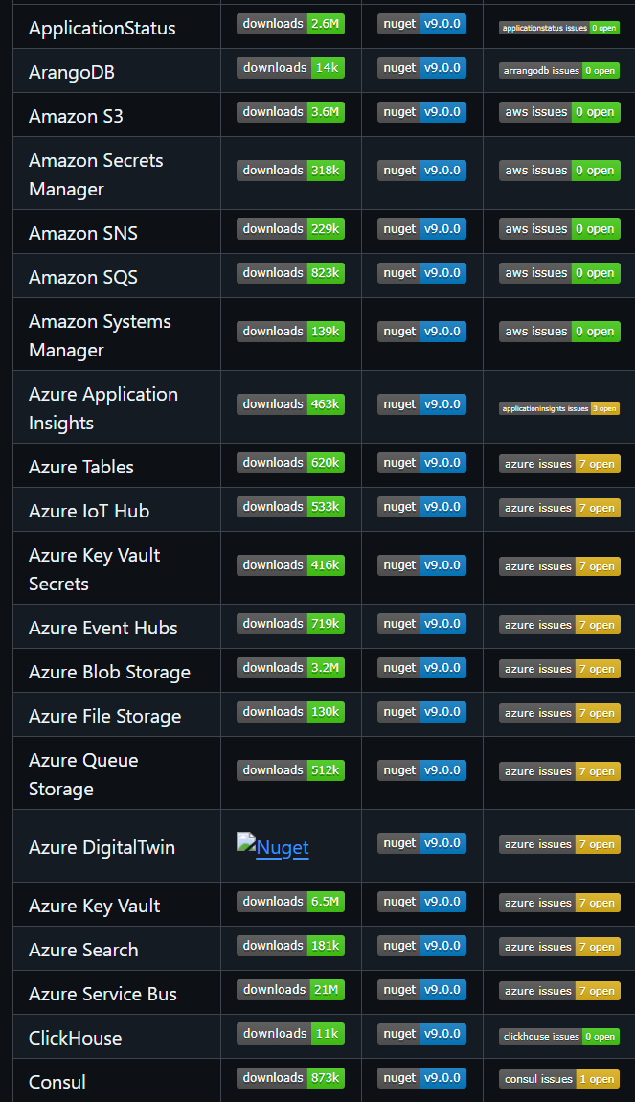
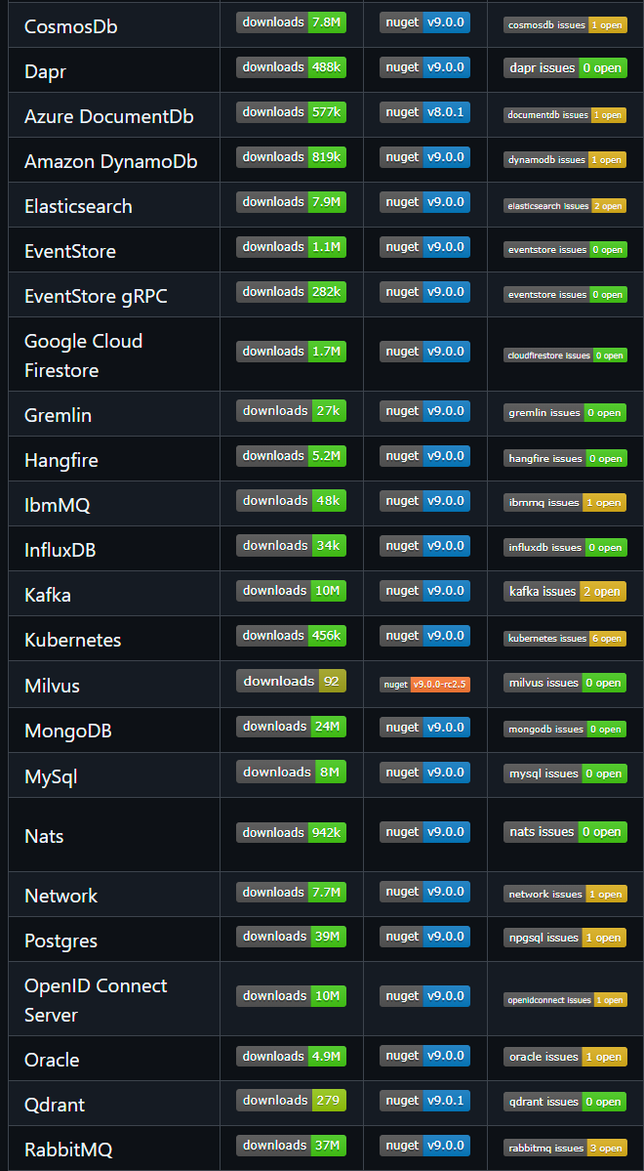
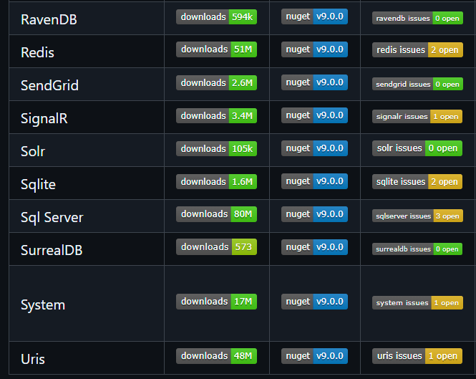
Notes:
There’s a github organization called “Xabaril”, and they went and implemented checks for a lot of the big ones
A bunch of azure stuff, Amazon DynamoDB, IBM MQ, RabbitMQ, Redis, and bunch of others

Slide 12
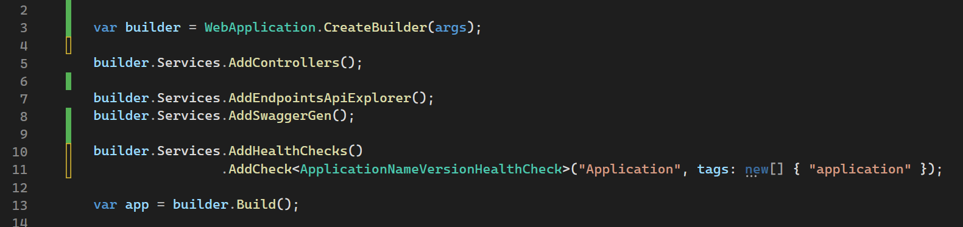
Creating the check is step 1
We still must register the checks
Notes:
Now that we have our checks implemented, we need to register them with the dependency injection container.
We do that by calling Services.AddHealthChecks [CLICK] - AddHealthChecks returns a builder, and on that builder, you add your checks.
Checks need a name [CLICK]

Slide 13
Creating the check is step 1
We still must register the checks
Notes:
And a collection of tags [CLICK]
The name must be unique across all registered checks, and ideally not contain spaces.

Slide 14
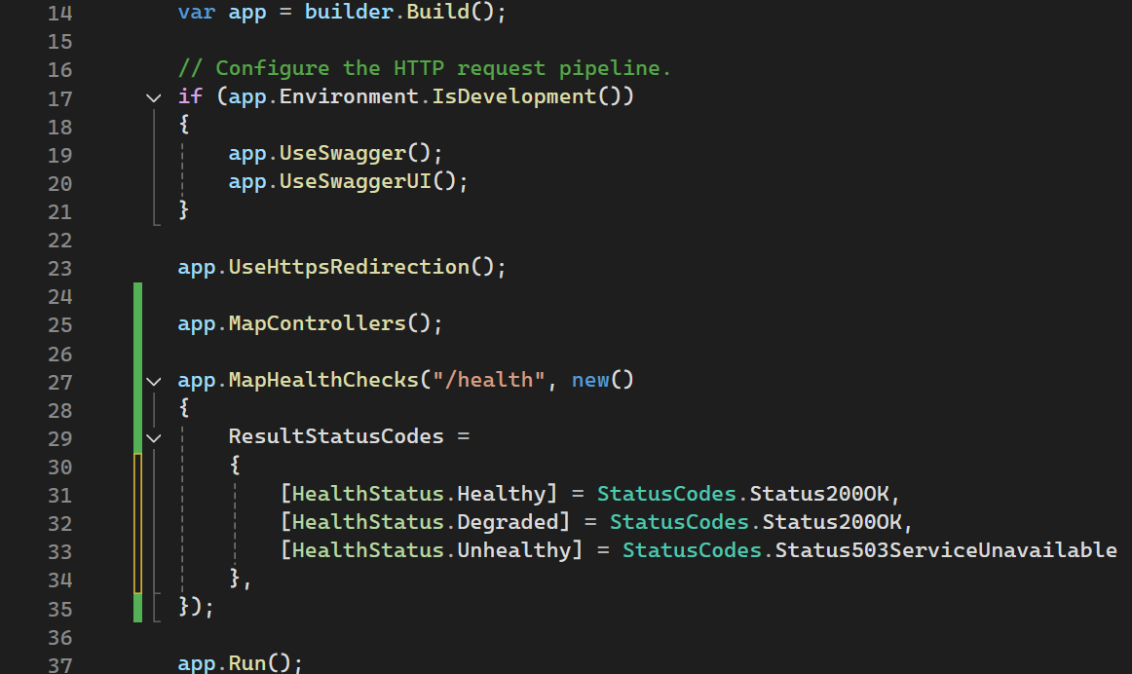
Advertising the checks
Notes:
Now that our checks have been added, it’s time to advertise them.
Rather than being a special kind of controller, Microsoft implemented the handler for health checks as middleware. There’s a few performance reasons for it, but ignoring that, having it as middleware allows to opt out of the autogenerated open api spec you advertise to your consumers.
They leave it to you to define the route, and how healthy, degraded, and unhealthy map to http status codes.
The recommendation is for Healthy and degraded to return a 200, and for unhealthy to return a 503 – but if you want something else, it can be whatever you want it to be – The statuses map to an int, so if you want to return a 418, off you go. [CLICK]

Slide 15
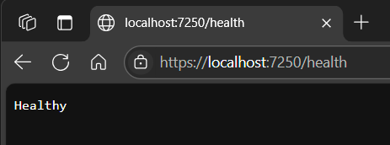
Notes:
And so when we run our application, and issue a HTTP GET against that health endpoint, what we get is the overall status of our health report.
Now, this is great, but what if we want to see how this breaks down, check by check? [CLICK]

Slide 16
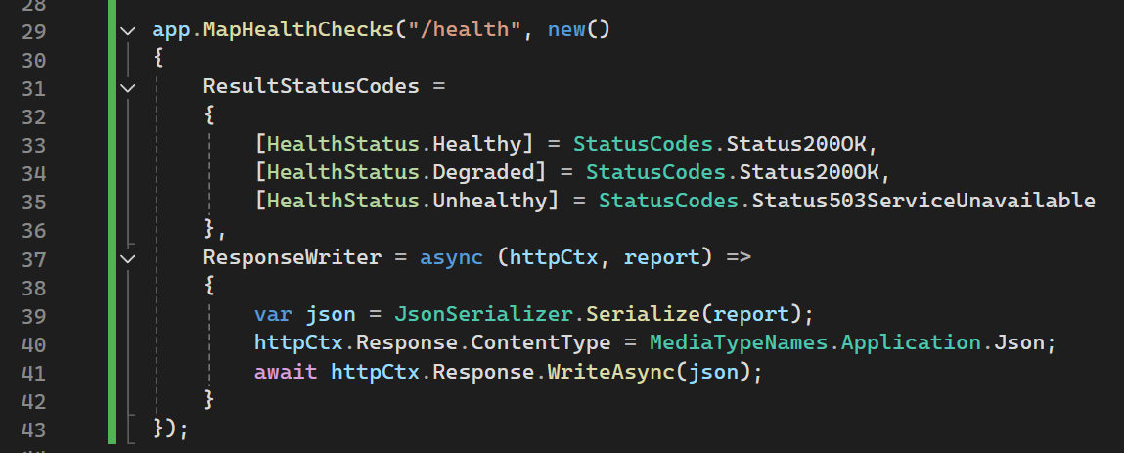
Notes:
Well, we just come back to our endpoint registration. In addition to status code mapping, Microsoft gives us a delegate for writing the response body. We get the full report, and access to the http context, so however you want to respond, the sky is really the limit here. For us at the credit union, we just serialize the full health report.

Slide 17
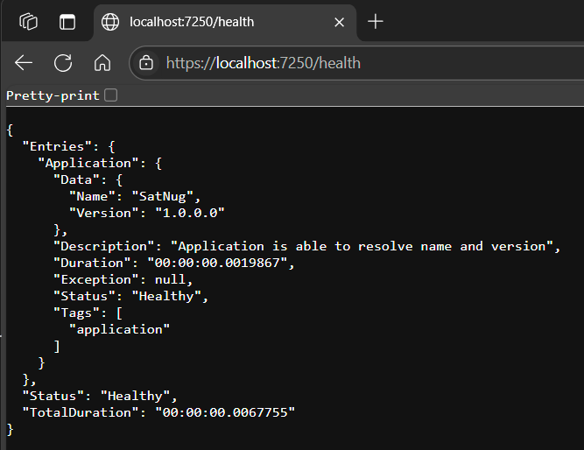
Notes:
You’ll see that with the custom response writer, our application is still healthy, but now we get a much better breakdown of why its healthy.
With this knowledge in place, we can start to do some cool stuff with it. But there’s one other thing I want to show, and that’s the concept of heartbeats.
With what we have right now, every time we execute a health check, we’re executing every registered check. And that’s fine, but hit it too often, and you start introducing artificial load on your downstream resources. You can imagine that if you gave what we have right now to some network guy, they would ping it every 500 milliseconds, and then the database people would start yelling at you and all of a sudden you’ve got a mess on your hands. [CLICK]

Slide 18
API
API
API
/Health
Notes:
Additionally, if you’re hitting internal services, and they advertise the same health check logic, a health check request on a top level service can easily have this unintended domino effect if you’re not careful.

Slide 19
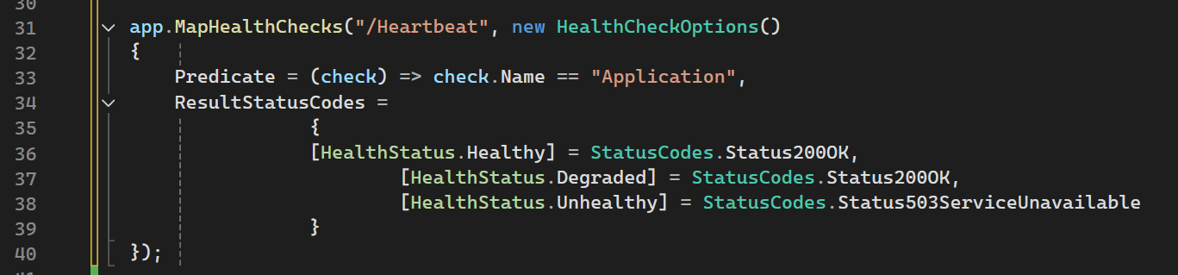
Notes:
And so that’s why at the credit union, in addition to advertising a full health report at health endpoint, we utilize the same infrastructure to run a single check at the heartbeat endpoint – health check options gives you a predicate that lets you only run a subset of all the registered checks. In our case, when we execute a heartbeat check, we only want that name version check that we discussed earlier.

Slide 20
API
API
/Heartbeat
/Health
Notes:
If you’re developing like we do, any check you write should reach out to the heartbeat endpoint of a downstream service, not the health endpoint. This allows you determine availability of the service without triggering a spiderweb of requests. You can also give that endpoint to the your load balancer guys, and they can route traffic based on your response times

Slide 21
Monitoring
Notes:
With all of that in place, this is a good spot to talk about monitoring

Slide 22
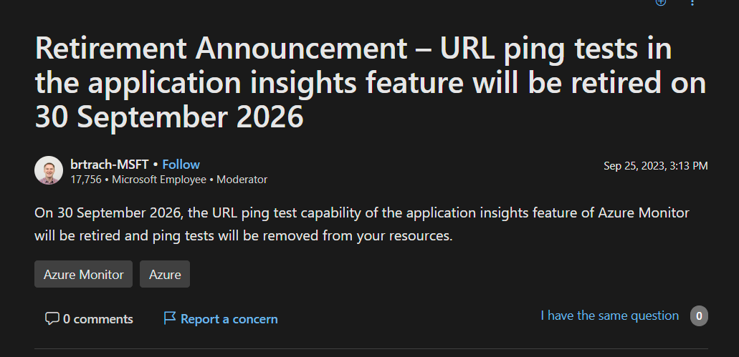
Notes:
Originally when I was putting this presentation together, I was going to walk you through writing a URL ping test in Azure, but I did a little research, and found that they’re going to be shutting this feature down next year. And so I don’t want to show you how to do something, have you build stuff on top of it, only for it to be taken away shortly after you built it. If you want to do it anyway, it’s still available in Application insights right now.

Slide 23
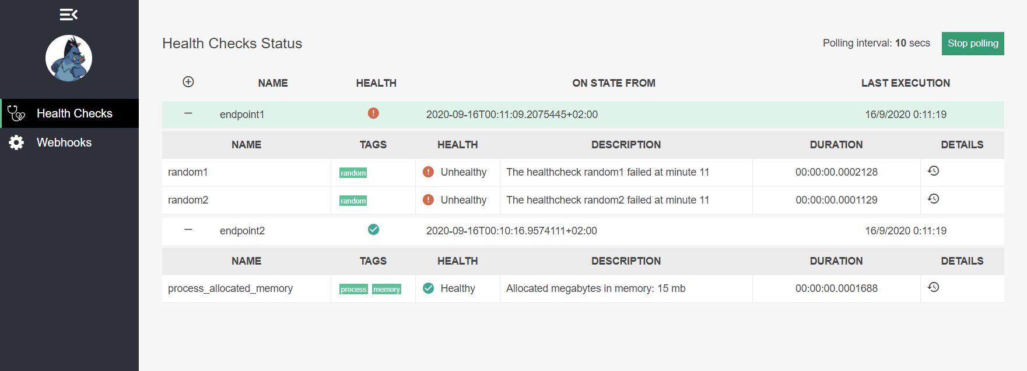
Notes:
Do you remember that github organization that we talked about earlier, Xabril?
Well, they have a health checks UI project that you can self host. In the project’s configuration, you give it a collection of urls, and at a interval, you specify, they’ll execute it. Results are stored in a database so you can see history, and if you configure the web hooks, there’s an option to be notified by Teams, Slack, or an Azure function when a failure response comes back. They also have a docker image if you want to run it that way. [CLICK]

Slide 24
Load Balancer
API
/Health
/Health
Notes:
There’s one problem with these two solutions – The URL you give them is almost always behind a load balancer of some kind. So this isn’t a problem if you only have one instance behind the load balancer – [CLICK]

Slide 25
API
/Health
Load Balancer
/Health
API
/Health
Notes:
But what if you have two?
Well, you can do something with the host header, or put a custom routing rule in that allows you to target a specific box if you match a certain pattern – but all of these choices still have the same problem – you’re introducing artificial load on your service when you don’t need to.

Slide 26
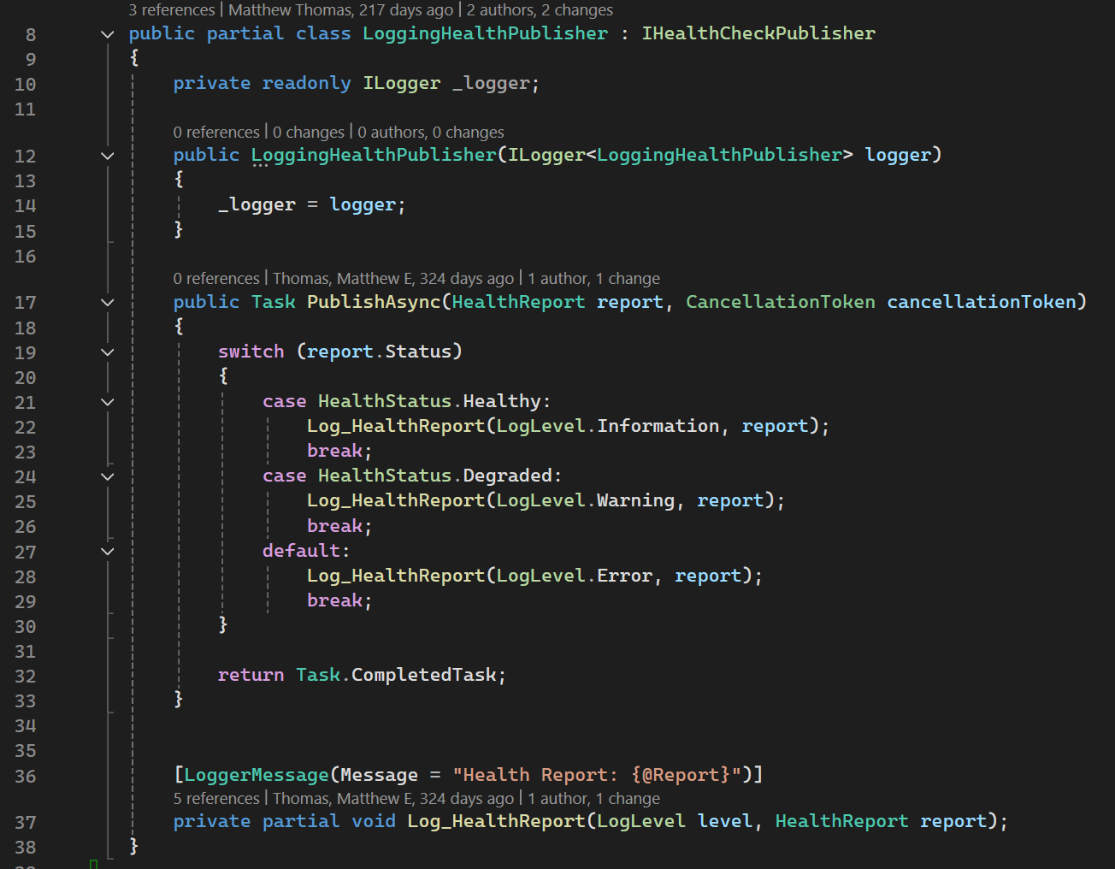
IHealthCheckPublisher
Notes:
That’s where health check publishers come into play. When you register this with dependency injection, every 30 seconds a background worker will run, generate a full health report, instantiate your publisher and call your PublishAsync method. From there it’s on you to send it wherever you see fit, however you see fit. The 30 seconds is configurable, and like with the endpoints, there’s predicate so that you have the option of running a subset of registered checks. [CLICK]
At the credit union, we implemented a logging health check publisher. By sending reports through the logging system, we flex all the existing infrastructure that’s in place for normal application logging - and because of that, we get alerting and historical analysis for free. [CLICK]

Slide 27
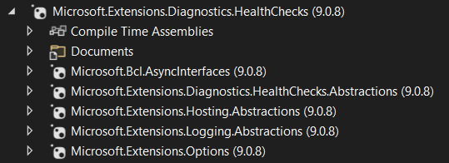
Something Microsoft never told you
Notes:
All of this is cool stuff right? I mean that’s not a lot of effort required on your part to get started here.
But here’s something interesting. [CLICK]
All of this stuff is defined in the Microsoft.Extensions.Diagnostics.HealthChecks package.
If we open it up and see what it requires – you’ll notice there’s nothing in there about ASP.Net
Which means we can use this in our console apps and windows services. Windows services are long running just like web applications, so they can make use of the health check publisher just like web apis can.
Console apps are a one and done kind of thing, but we can use them to verify connectivity to our downstream resources. [CLICK]

Slide 28
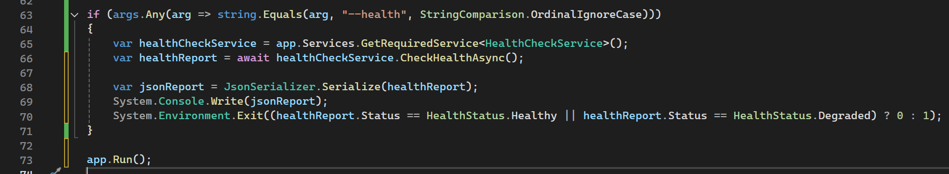
Notes:
All you have to do is just look for an argument flag before running your application.
If you get that flag, just resolve the health check service, get a health report, write it out, and exit.
Here at the credit union, all of our applications support this feature – APIs, windows services, and console apps. Because of that, our deployment pipelines can execute a health check on the prospective version of the code on the box while the prior version is still running. Remember, in .Net core, everything is a console app, even web applications. If the health check fails, we abort the deployment, and end users are none the wiser. But if it passes, we have a much higher level of confidence that the new version is going to function as intended, and we can proceed with the deployment. [CLICK]

Slide 29
Some resources
Microsoft documentation
https://devblogs.microsoft.com/dotnet/asp-net-core-2-2-0-preview1-healthcheck
https://learn.microsoft.com/en-us/aspnet/core/host-and-deploy/health-checks
Xabaril project on GitHub
https://github.com/Xabaril/AspNetCore.Diagnostics.HealthChecks
“The Usual”
StackOverflow
Developer blogs
YouTube
Google
Notes:
I’ll leave you with some links to check out – there’s a lot to read in the official documentation, and even more in Xabaril’s project on github. I know it’s a little old, but check out the original announcement post – all the concepts in there are still relevant today.
I know we’re living in the age of AI where you can ask a question and get a direct answer, but stack overflow, developer blogs, YouTube, and a good old google search are your friend.

Slide 30
HealthChecks
The .Net feature you’re probably not using
Notes:
And with that, I’ll end it here, I know this was a bit shorter than the hour we’ve been allocated - but like I stated at the beginning this is a pretty easy concept to implement.
So, I’ll open it up for questions

